Slide 1
Awareness Over Distributed Version Control Systems
Cristiano Cesário - ccesario@ic.uff.br
Instituto de Computação – Universidade Federal Fluminense (UFF)
DyeVC está disponível em http://gems.ic.uff.br/dyevc

Slide 2
Conceito: Repositórios Centralizados x Distribuídos
Introdução
Motivação
Trab. Relacionados
Abordagem
Conclusão
Avaliação
Área de Trabalho
Repositório
Repositório
clone / pull
check-out / update
check-in / commit
push
Repositório
check-out / update
Área de Trabalho
commit
Área de Trabalho
Repositório Centralizado
Repositório Distribuído
Extraído de MURTA 2012.

Slide 3
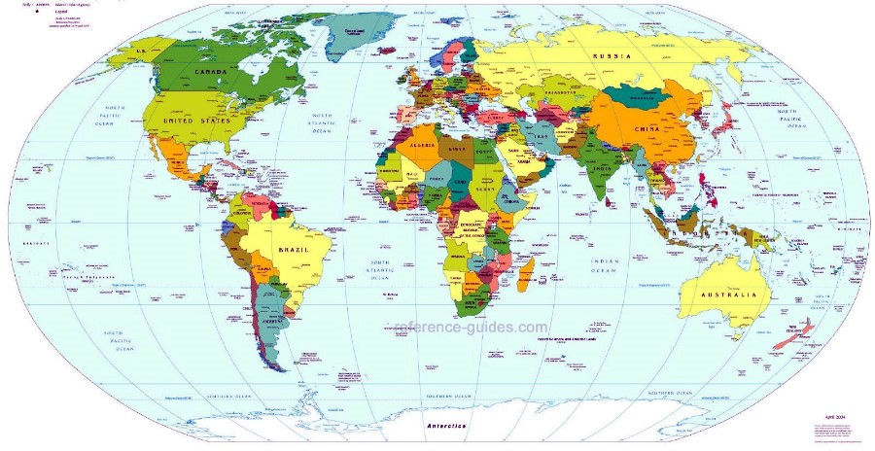
Motivação
Introdução
Motivação
Trab. Relacionados
Abordagem
Conclusão
Avaliação
Globalização
Desenvolvimento de Software também é distribuído
Fatores de risco[Battin et al. 2001]
Notes:
Physical distance
Time zone disparity
Domain expertise
Architecture
Software integration
Software conf. mngt.
Vendor support
Governmental issues
Development process
Local impression of remote terms

Slide 4


Motivação
Introdução
Motivação
Trab. Relacionados
Abordagem
Conclusão
Avaliação
Difícil colaboração e percepção de mudanças
?

Slide 5
Motivação
Introdução
Motivação
Trab. Relacionados
Abordagem
Conclusão
Avaliação
Uso crescente de repositórios distribuídos
Fonte: Eclipse Foundation. The Open Source Developer Report - 2013 Eclipse Community Survey.

Slide 6
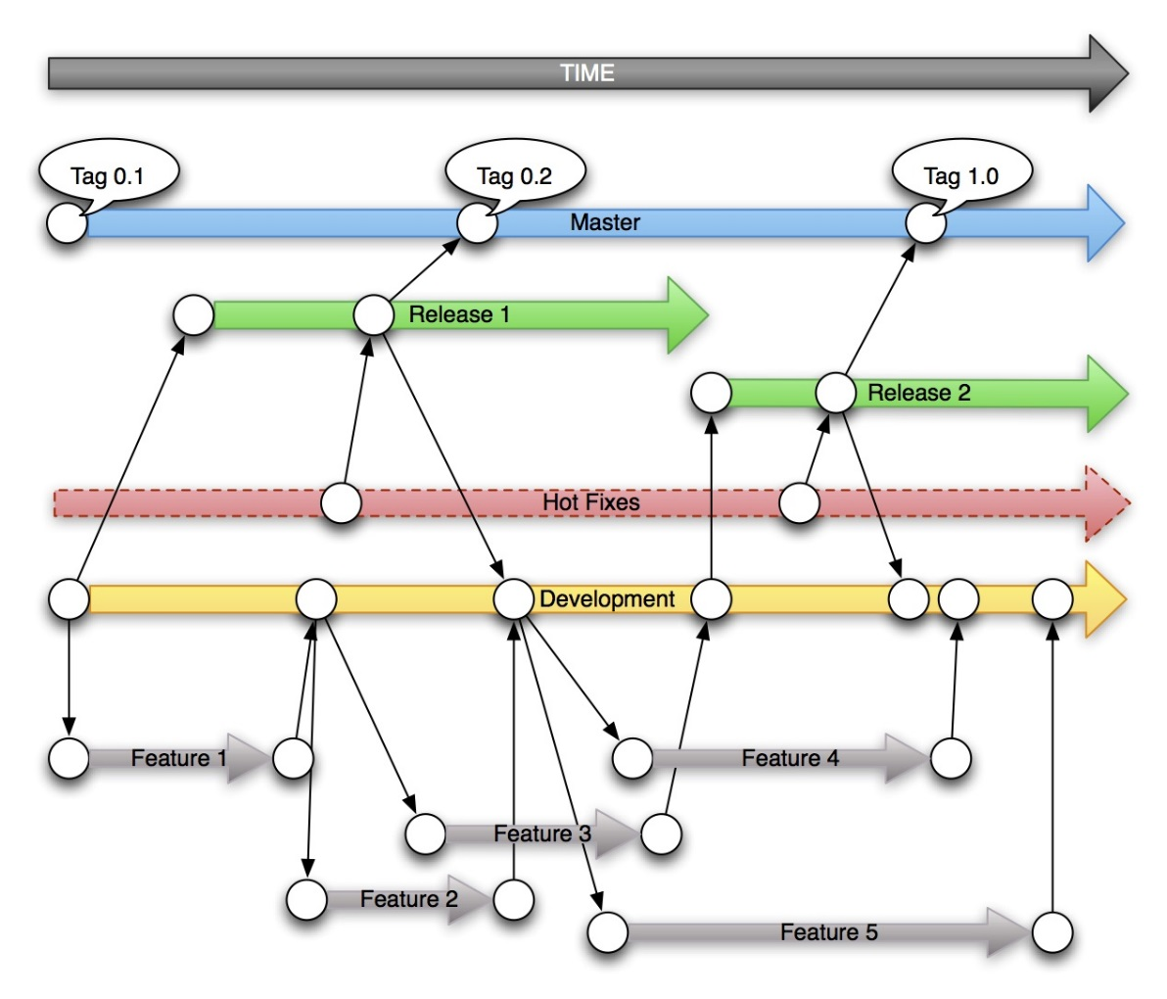
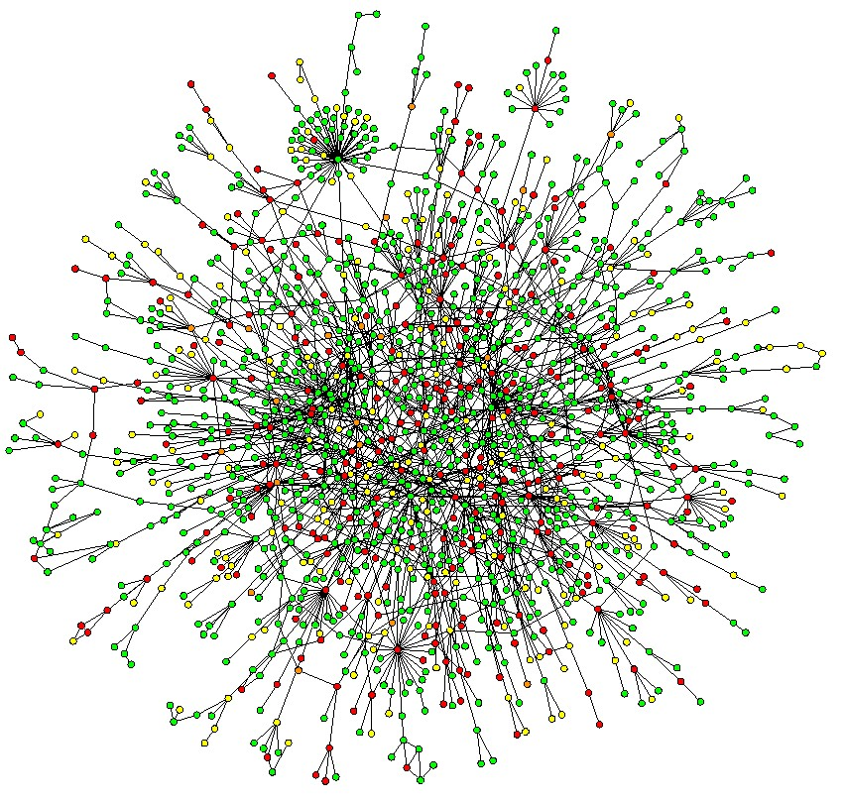
Motivação
Introdução
Motivação
Trab. Relacionados
Abordagem
Conclusão
Avaliação
Uso crescente de repositórios distribuídos
Proliferação de ramos
Notes:
Proliferação de ramos

Slide 7
Motivação
Introduction
Motivation
Related Work
Approach
Conclusion
Evaluation
master
1
2
3
master
master
master
1
2
3
1
2
3
4
6
1
2
3
4
6
8
5
7
5
7
issue55
issue55
issue55
(a)
(b)
(c)
Notes:
Physical distance
Time zone disparity
Domain expertise
Architecture
Software integration
Software conf. mngt.
Vendor support
Governmental issues
Development process
Local impression of remote terms

Slide 8
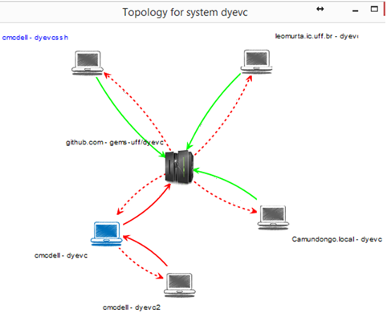

Slide 9
Motivation
Introduction
Motivation
Related Work
Approach
Conclusion
Evaluation
Original repository
Clones
1
2
3
4’
5’
6’
Clone A
1
2
3
1
2
3
4’’
Clone B
1
2
3
4’’’
5’’’
6’’’
7’’’
Clone C
Notes:
Physical distance
Time zone disparity
Domain expertise
Architecture
Software integration
Software conf. mngt.
Vendor support
Governmental issues
Development process
Local impression of remote terms

Slide 10
Motivation
Introduction
Motivation
Related Work
Approach
Conclusion
Evaluation
Original repository
Clones
1
2
3
4’’
Clone B
1
2
3
4’
5’
6’
1
2
3
4’’’
5’’’
6’’’
7’’’
Clone C
Original repository
Clones
1
2
3
4’’
5’’
Clone B
1
2
3
4’
5’
6’
4’
5’
6’
1
2
3
4’’’
5’’’
6’’’
7’’’
Clone C
Notes:
Physical distance
Time zone disparity
Domain expertise
Architecture
Software integration
Software conf. mngt.
Vendor support
Governmental issues
Development process
Local impression of remote terms

Slide 11
Motivation
Introduction
Motivation
Related Work
Approach
Conclusion
Evaluation
Original repository
Clones
1
2
3
4’’
5’’
1
2
3
4’’’
5’’’
6’’’
7’’’
Clone C
4’
5’
6’
Original repository
Clones
1
2
3
4’’
5’’
1
2
3
4’’’
5’’’
6’’’
7’’’
8’’’
Clone C
4’
5’
6’
4’’
5’’
4’
5’
6’
Notes:
Physical distance
Time zone disparity
Domain expertise
Architecture
Software integration
Software conf. mngt.
Vendor support
Governmental issues
Development process
Local impression of remote terms

Slide 12
Motivation
Introduction
Motivation
Related Work
Approach
Conclusion
Evaluation
Original repository
Clone B
master
master
1
2
3
4’
5’
6’
1
2
3
4’’
4’
5’
6’
origin/master
Original repository
master
Clone B
master
1
2
3
4’’
5’’
1
2
3
4’’
5’’
4’
5’
6’
4’
5’
6’
origin/master
Notes:
Physical distance
Time zone disparity
Domain expertise
Architecture
Software integration
Software conf. mngt.
Vendor support
Governmental issues
Development process
Local impression of remote terms

Slide 13
Motivation
Introduction
Motivation
Related Work
Approach
Conclusion
Evaluation
master
1
2
3
4
5
Notes:
Physical distance
Time zone disparity
Domain expertise
Architecture
Software integration
Software conf. mngt.
Vendor support
Governmental issues
Development process
Local impression of remote terms

Slide 14



Motivation
Introduction
Motivation
Related Work
Approach
Conclusion
Evaluation
Xavier Institute
Wolverine
Gambit
Professor Xavier
Rogue
Nightcrawler
Cyclops
Jean Gray
Mystique
Beast

Slide 15
Motivation
Introduction
Motivation
Related Work
Approach
Conclusion
Evaluation
Xavier Institute
Wolverine
Storm
Gambit
Professor Xavier
Rogue
Nightcrawler
Cyclops
Jean Gray
Mystique
Push
Beast
Pull

Slide 16
Questions
Introduction
Motivation
Related Work
Approach
Conclusion
Evaluation
Developer
How can I know at a given moment if there are commits that were not pulled yet?
Are there any local commits pending to be pushed?
Administrator
What are the existing clones of a system?
Who and how do they relate with?
How can I know if there are pending commits to be sent from a test repository to a production one?

Slide 17
Related Work
Introduction
Motivation
Related Work
Approach
Conclusion
Evaluation
Awareness Tools
Conflict Avoidance
Conflict Detecting
Visualization
Repository Linearization

Slide 18
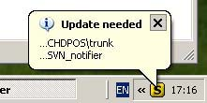
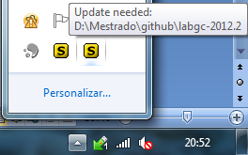
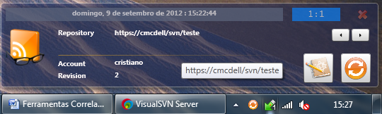
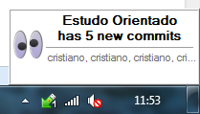
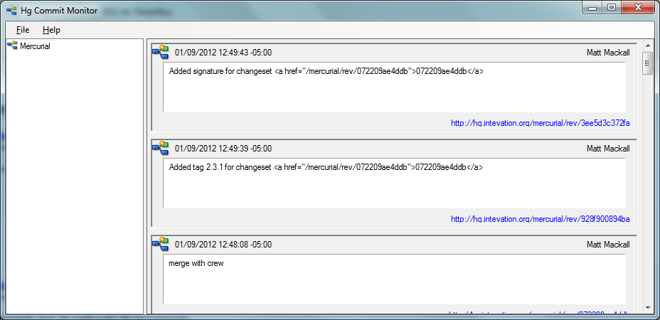
Related Work
Introduction
Motivation
Related Work
Approach
Conclusion
Evaluation
SVN Notifier
Elvin
SCM Notifier
SVN Radar
Commit Monitor

Slide 19
Related Work
Introduction
Motivation
Related Work
Approach
Conclusion
Evaluation
SVN Notifier
SCM Notifier
Commit Monitor
Elvin

Slide 20

Related Work - Awareness Tools
Introduction
Motivation
Related Work
Approach
Conclusion
Evaluation
Conflict avoidance
Report new commits
Do not identify related repositories
Do not present information in different levels
SVN Notifier¹, SCM Notifier², Commit Monitor³, SVN Radar⁴ and Hg Commit Monitor⁵
¹http://svnnotifier.tigris.org/ (2012)
²https://github.com/pocorall/scm-notifier (2012)
³http://tools.tortoisesvn.net/CommitMonitor.html (2013)
⁴http://code.google.com/p/svnradar/ (2011)
⁵http://www.fsmpi.uni-bayreuth.de/~dun3/hg-commit-monitor (2009)

Slide 21

Related Work - Awareness Tools
Introduction
Motivation
Related Work
Approach
Conclusion
Evaluation
Conflict detecting
CollabVS [Dewan and Hegde 2007], Crystal [Brun et al. 2011], FASTDash [Biehl et al.], Lighthouse [Da Silva et al. 2006], Palantir [Sarma and Van der Hoek 2002], Polvo [Santos and Murta 2012], WeCode [Guimarães and Silva 2012], Safe-Commit [Wloka et al. 2009]
Identify existing or potential conflicts
Only one supports DVCSs
Do not support scenarios with multiple partners

Slide 22
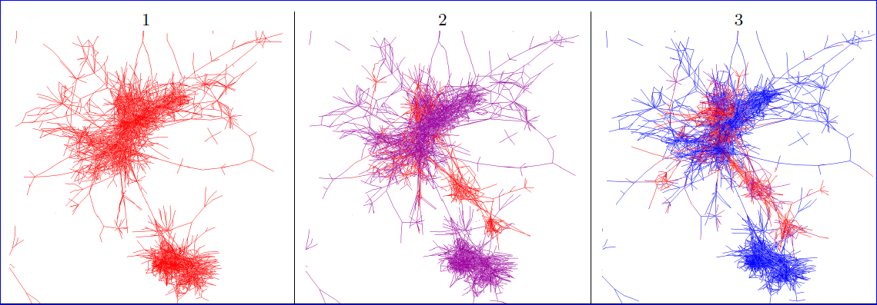
Related Work - Repository Linearization
Introduction
Motivation
Related Work
Approach
Conclusion
Evaluation
Gevol [Collberg et al 2003]: Focus on program structure

Slide 23
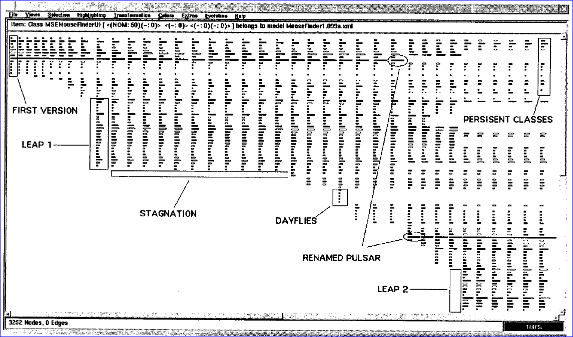
Related Work - Repository Linearization
Introduction
Motivation
Related Work
Approach
Conclusion
Evaluation
The Evolution Matrix [Lanza 2001]: Focus on classes

Slide 24
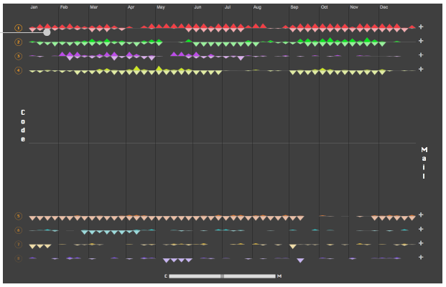
Related Work - Repository Linearization
Introduction
Motivation
Related Work
Approach
Conclusion
Evaluation
LifeSource[Gilbert and Karahalios 2006]: Focus on Authors

Slide 25
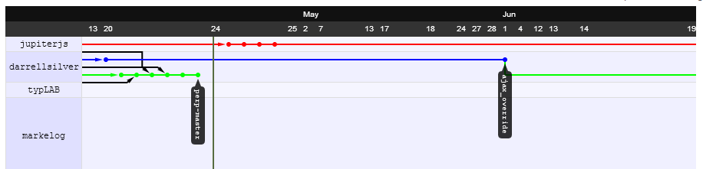
Related Work - Repository Linearization
Introduction
Motivation
Related Work
Approach
Conclusion
Evaluation
VisGi [Elsen 2013]: Focus on Branches
GitHub’s Network Graph: Focus on Branches

Slide 26
Related Work
Introduction
Motivation
Related Work
Approach
Conclusion
Evaluation
Most of the linearization tools work with CVCS’s
A few exceptions…
… which do not show where a given commit can be found
… which cannot be easily extended
No tools found for topology visualization

Slide 27


DyeVC*
Introduction
Motivation
Related Work
Approach
Conclusion
Evaluation
DyeVC Database
rep
rep
rep
rep’
rep’
rep’
DyeVC App
DyeVC App
DyeVC App
*Dye over Version Control

Slide 28


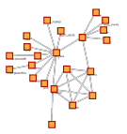

Technology Used
Introduction
Motivation
Related Work
Approach
Conclusion
Evaluation
Java Web Start
Jgit Library
JUNG* Framework
MongoDB
*Java Universal Network/Graph Framework
Notes:
JUNG: Java Universal Network/Graph Framework

Slide 29





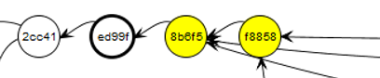
Different Visualization Levels
Introduction
Motivation
Related Work
Approach
Conclusion
Evaluation
Level 1: Repositories
Level 2: Branches
Level 3: Commits

Slide 30
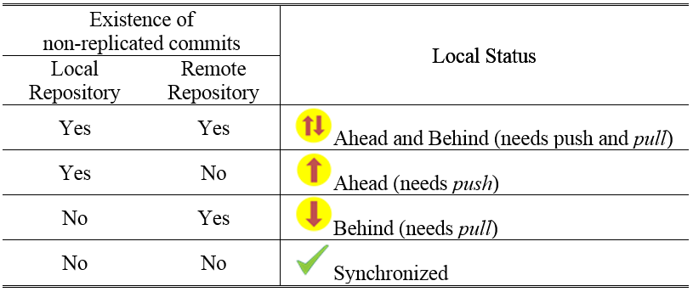
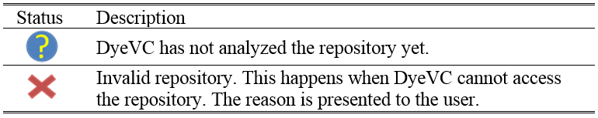
Possible state for a repository
Introduction
Motivation
Related Work
Approach
Conclusion
Evaluation

Slide 31
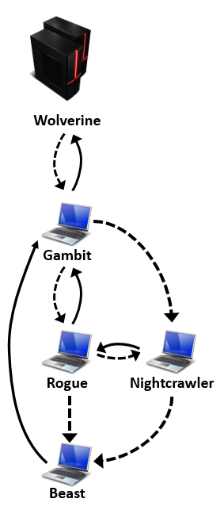
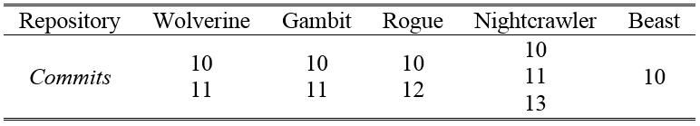
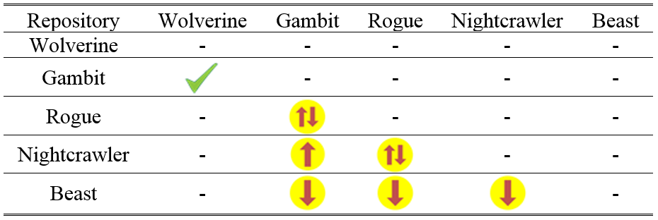
Example
Introduction
Motivation
Related Work
Approach
Conclusion
Evaluation

Slide 32
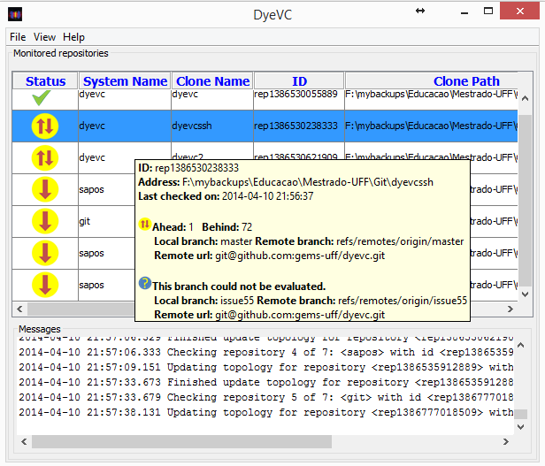
DyeVC - Main Screen
Introduction
Motivation
Related Work
Approach
Conclusion
Evaluation

Slide 33
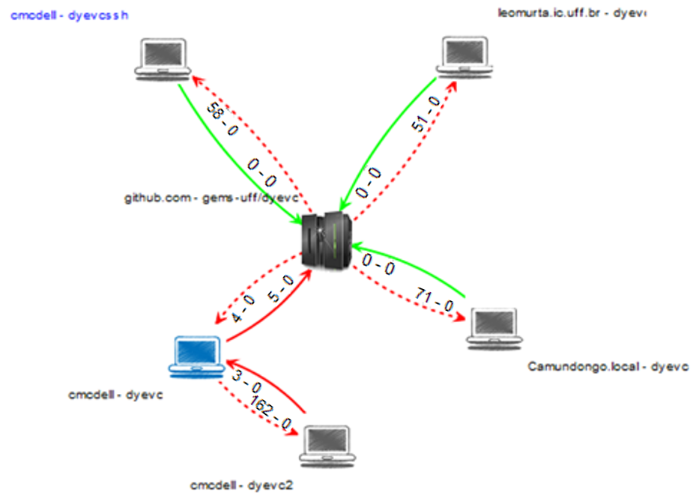
Visão de Topologia
Introduction
Motivation
Related Work
Approach
Conclusion
Evaluation
Parceiro
Repositório central
Meu repositório

Slide 34
Visão de Topologia
Introduction
Motivation
Related Work
Approach
Conclusion
Evaluation
Push, sincronizado
Push, não sincronizado
Pull, sincronizado
Pull, não sincronizado
Commits em ramos não rastreados
Commits em ramos rastreados

Slide 35
3
2
4
8
1
5
7
6

Slide 36
3
2
4
8
1
5
7
6

Slide 37
3
2
4
8
1
5
7
6

Slide 38
3
2
4
8
1
5
7
6

Slide 39
3
2
4
8
1
5
7
6

Slide 40
Node Positions
1
2
3
5
6
8
4
7
Predecessor
Successors
1
2
3
5
6
8
4
7
1
2
3
5
6
8
4
7

Slide 41
0
S
M
A
-20
-40
-60
B
-80
-100
C

Slide 42
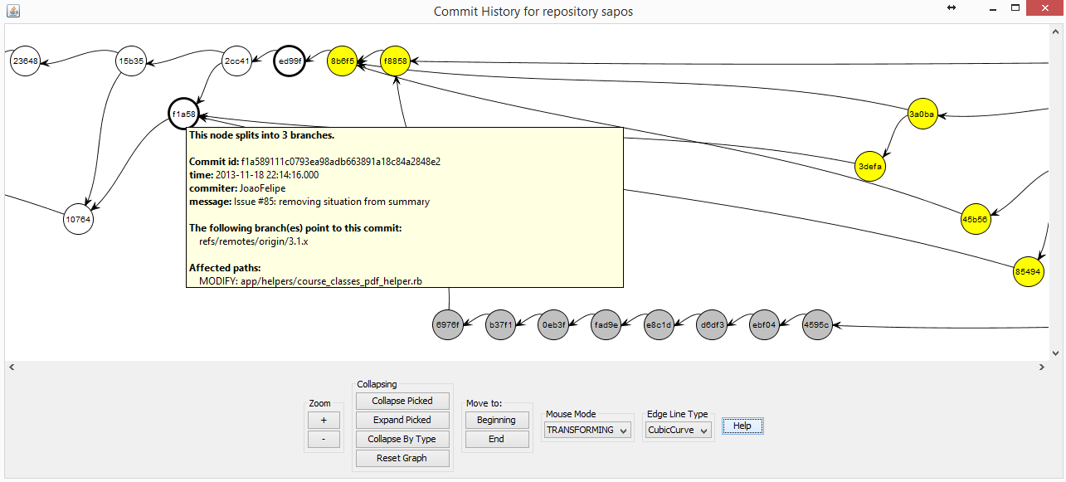
Commit History
Introduction
Motivation
Related Work
Approach
Conclusion
Evaluation

Slide 43
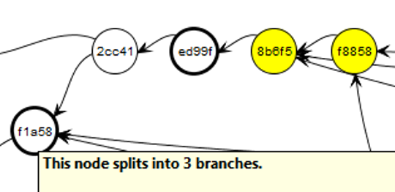
Commit History
Introduction
Motivation
Related Work
Approach
Conclusion
Evaluation

Slide 44
História de Commits - Códigos de Cores
Introduction
Motivation
Related Work
Approach
Conclusion
Evaluation
Onde o commit existe
Ramos e tags
fffff
Todos possuem
fffff
Commit regular
fffff
Não foi feito push para todos os parceiros
fffff
Apontado por um ramo
fffff
fffff
Não foi feito pull
Apontado por uma tag
fffff
Existe em alguém que não é parceiro
fffff
Está em um ramo não rastreado

Slide 45
Evaluation
Introduction
Motivation
Related Work
Approach
Conclusion
Evaluation
Quantitative evaluation performed
Main operations measured
Open source repositories
Jgit
DyeVC
Tortoise Git
Drupal
Expresso Livre
Git

Slide 46
Evaluation
Introduction
Motivation
Related Work
Approach
Conclusion
Evaluation

Slide 47
Evaluation
Introduction
Motivation
Related Work
Approach
Conclusion
Evaluation

Slide 48
Evaluation
Introduction
Motivation
Related Work
Approach
Conclusion
Evaluation
Current limitation in commit history ≈ 7000

Slide 49
Evaluation
Introduction
Motivation
Related Work
Approach
Conclusion
Evaluation

Slide 50
Conclusion
Introduction
Motivation
Related Work
Approach
Conclusion
Evaluation
DyeVC is a non-obtrusive tool to visualize dependencies among DVCSs
Monitors repositories continuously
Extensible, allowing new plugins and layouts
Response time and scalability depends upon the desired information granularity and repository size

Slide 51
Future Work
Introduction
Motivation
Related Work
Approach
Conclusion
Evaluation
Different plugins for commit history
Collapse commits with same level of accessibility
Filter by author, date, etc.
New layouts to display different metrics
A few already created within our group
Integration with other awareness tools
E.g. Polvo, Kraken

Slide 52
References
Introduction
Motivation
Related Work
Approach
Conclusion
DyeVC homepage: http://gems.ic.uff.br/dyevc/
Source code: https://github.com/gems-uff/dyevc
User Manual: https://github.com/gems-uff/dyevc/wiki/User-Manual

Slide 53
Providing Visualizations for Distributed Version Control Systems
Thank You!
Cristiano Cesário - ccesario@ic.uff.br
Instituto de Computação – Universidade Federal Fluminense (UFF)
DyeVC is available at http://gems.ic.uff.br/dyevc

Slide 54
DyeVC
Introduction
Motivation
Related Work
Approach
Conclusion
Evaluation
Definition, according to Maletic et al*
Tasks
Audience
Target
Medium
Representation
Developer awareness
Administrator’s / Managers aid tool
Extensible platform to present information regarding DVCS
*Maletic et al. A task oriented view of software visualization
Notes:
The tasks are three-fold. First, DyeVC should work as a non-obtrusive awareness tool to increase the developer knowledge of what is going on around his repository and the repositories of his teammates. Second, DyeVC should enable repository administrators / managers to visualize how the several existing repositories of a system interact with each other. Third, DyeVC should establish an extensible platform to present different information and metrics regarding DVCS.
The audience of DyeVC is everyone involved with implementing software through the usage of distributed version control systems. The main roles that DyeVC immediately benefits are system administrators and developers, but due to its extensibility, different views can be developed to support different roles.
The target of DyeVC is any local DVCS clone of a repository hosted on a Git server, such as local Git servers, GitHub, Gitorious or Bitbucket.
The medium used by DyeVC can be a simple message in the notification area, or a window in the user’s desktop.
The representation should be appropriate to show the information in each different visualization. For instance, the various clones and their relationships use a network topology metaphor and the repository history use a directed acyclic graph visualization.
https://github.com/
https://gitorious.org/
http://bitbucket.org/

Slide 55
DyeVC
Introduction
Motivation
Related Work
Approach
Conclusion
Evaluation
Definition, according to Maletic et al*
Tasks
Audience
Target
Medium
Representation
Everyone involved with software implementation
*Maletic et al. A task oriented view of software visualization
Notes:
The tasks are three-fold. First, DyeVC should work as a non-obtrusive awareness tool to increase the developer knowledge of what is going on around his repository and the repositories of his teammates. Second, DyeVC should enable repository administrators / managers to visualize how the several existing repositories of a system interact with each other. Third, DyeVC should establish an extensible platform to present different information and metrics regarding DVCS.
The audience of DyeVC is everyone involved with implementing software through the usage of distributed version control systems. The main roles that DyeVC immediately benefits are system administrators and developers, but due to its extensibility, different views can be developed to support different roles.
The target of DyeVC is any local DVCS clone of a repository hosted on a Git server, such as local Git servers, GitHub, Gitorious or Bitbucket.
The medium used by DyeVC can be a simple message in the notification area, or a window in the user’s desktop.
The representation should be appropriate to show the information in each different visualization. For instance, the various clones and their relationships use a network topology metaphor and the repository history use a directed acyclic graph visualization.
https://github.com/
https://gitorious.org/
http://bitbucket.org/

Slide 56
DyeVC
Introduction
Motivation
Related Work
Approach
Conclusion
Evaluation
Definition, according to Maletic et al*
Tasks
Audience
Target
Medium
Representation
Any local DVCS clone of a repository hosted on a Git server
*Maletic et al. A task oriented view of software visualization
Notes:
The tasks are three-fold. First, DyeVC should work as a non-obtrusive awareness tool to increase the developer knowledge of what is going on around his repository and the repositories of his teammates. Second, DyeVC should enable repository administrators / managers to visualize how the several existing repositories of a system interact with each other. Third, DyeVC should establish an extensible platform to present different information and metrics regarding DVCS.
The audience of DyeVC is everyone involved with implementing software through the usage of distributed version control systems. The main roles that DyeVC immediately benefits are system administrators and developers, but due to its extensibility, different views can be developed to support different roles.
The target of DyeVC is any local DVCS clone of a repository hosted on a Git server, such as local Git servers, GitHub, Gitorious or Bitbucket.
The medium used by DyeVC can be a simple message in the notification area, or a window in the user’s desktop.
The representation should be appropriate to show the information in each different visualization. For instance, the various clones and their relationships use a network topology metaphor and the repository history use a directed acyclic graph visualization.
https://github.com/
https://gitorious.org/
http://bitbucket.org/

Slide 57
DyeVC
Introduction
Motivation
Related Work
Approach
Conclusion
Evaluation
Definition, according to Maletic et al*
Tasks
Audience
Target
Medium
Representation
Messages in notification area
Dialogs in user’s desktop
*Maletic et al. A task oriented view of software visualization
Notes:
The tasks are three-fold. First, DyeVC should work as a non-obtrusive awareness tool to increase the developer knowledge of what is going on around his repository and the repositories of his teammates. Second, DyeVC should enable repository administrators / managers to visualize how the several existing repositories of a system interact with each other. Third, DyeVC should establish an extensible platform to present different information and metrics regarding DVCS.
The audience of DyeVC is everyone involved with implementing software through the usage of distributed version control systems. The main roles that DyeVC immediately benefits are system administrators and developers, but due to its extensibility, different views can be developed to support different roles.
The target of DyeVC is any local DVCS clone of a repository hosted on a Git server, such as local Git servers, GitHub, Gitorious or Bitbucket.
The medium used by DyeVC can be a simple message in the notification area, or a window in the user’s desktop.
The representation should be appropriate to show the information in each different visualization. For instance, the various clones and their relationships use a network topology metaphor and the repository history use a directed acyclic graph visualization.
https://github.com/
https://gitorious.org/
http://bitbucket.org/

Slide 58
DyeVC
Introduction
Motivation
Related Work
Approach
Conclusion
Evaluation
Definition, according to Maletic et al*
Tasks
Audience
Target
Medium
Representation
According to the information in each different visualization (e.g. network topology metaphor, DAG visualization)
*Maletic et al. A task oriented view of software visualization
Notes:
The tasks are three-fold. First, DyeVC should work as a non-obtrusive awareness tool to increase the developer knowledge of what is going on around his repository and the repositories of his teammates. Second, DyeVC should enable repository administrators / managers to visualize how the several existing repositories of a system interact with each other. Third, DyeVC should establish an extensible platform to present different information and metrics regarding DVCS.
The audience of DyeVC is everyone involved with implementing software through the usage of distributed version control systems. The main roles that DyeVC immediately benefits are system administrators and developers, but due to its extensibility, different views can be developed to support different roles.
The target of DyeVC is any local DVCS clone of a repository hosted on a Git server, such as local Git servers, GitHub, Gitorious or Bitbucket.
The medium used by DyeVC can be a simple message in the notification area, or a window in the user’s desktop.
The representation should be appropriate to show the information in each different visualization. For instance, the various clones and their relationships use a network topology metaphor and the repository history use a directed acyclic graph visualization.
https://github.com/
https://gitorious.org/
http://bitbucket.org/

